Slide 1

Delivery management System for U.P’s Catering
Saurabh Shekhar pisal – A20403781

Slide 2


SCOPE Why we need a project?
New delivery service expected to shoot the sales and Customer satisfaction
Rather the sales dropped and rating decreased from 4.5 to 4.2 out of 5

Slide 3






Manual workflow
Manual workflow
Employees utilized the main system to enter an order (only place using IT)
Printed order details after order delivery(address, phone #, time, date) and handed manually to order manager
Manager manually views current date order and gives the order to delivery boys
Delivery boy delivers and customers signs at the bottom of the receipt
All delivered slips are stapled together
Order manager add a delivery fee to invoice and puts in a file cabinet
Notes:
ISSUES DISCOVERED DURING THE ANALYSIS BY DALYNTON - ANALYST

Slide 4
Issues found
Employee forgets to print the order details and give to order manager
Handwritten information is sometimes illegible
Receipts are sometimes lost/destroyed
Customers don’t receive receipt copy during the delivery
Timely delivery is not cross-verified as per the commitment
Delivery information is not captured after the delivery into the company’s system
No CRM to track complaints by the customers

Slide 5
Purpose of this project
redefine the delivery process
Implement those changes to the current legacy system
Adding features like * Data captures, * delivery tracking, * auto-charging delivery fees, * delivery time slots

Slide 6






Scrum-Agile methodology will be used for development the delivery system
Reasons for using scrum are
Multiple iterations of 2 weeks
Each iteration will have a part of the product ready to deliver to the stakeholders
An estimate can be made on when the product will be release ready based on story points, the capacity of the team and the velocity as a reference to keep capacity at check
Any changes to the product / new features can be added to the product backlog
Analyst can do analysis based on the theme of the user story to help prioritize what should be built first

Slide 7

Value to the company
Leverage employee familiarity of the current system
Add delivery process automation which will increase employee efficiency
Solves most of the identified customer satisfaction concerns
Notes:
What issues / the companies objective to achives does it resolve/help

Slide 8
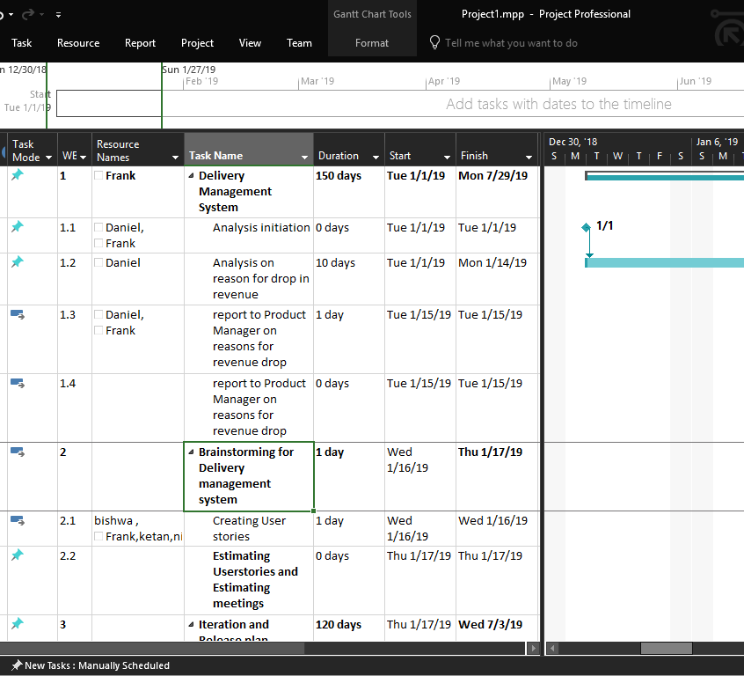
Milestones (Agile planning and Estimation)
Expected delivery of the project is 10-12 iterations i.e 20-24 weeks=5-6 months

Slide 9
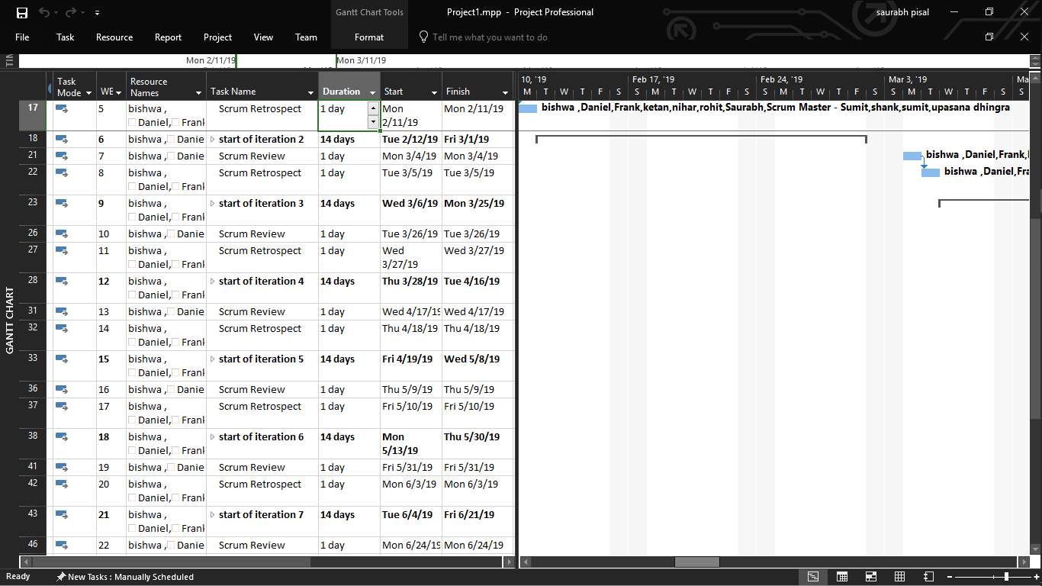

Slide 10
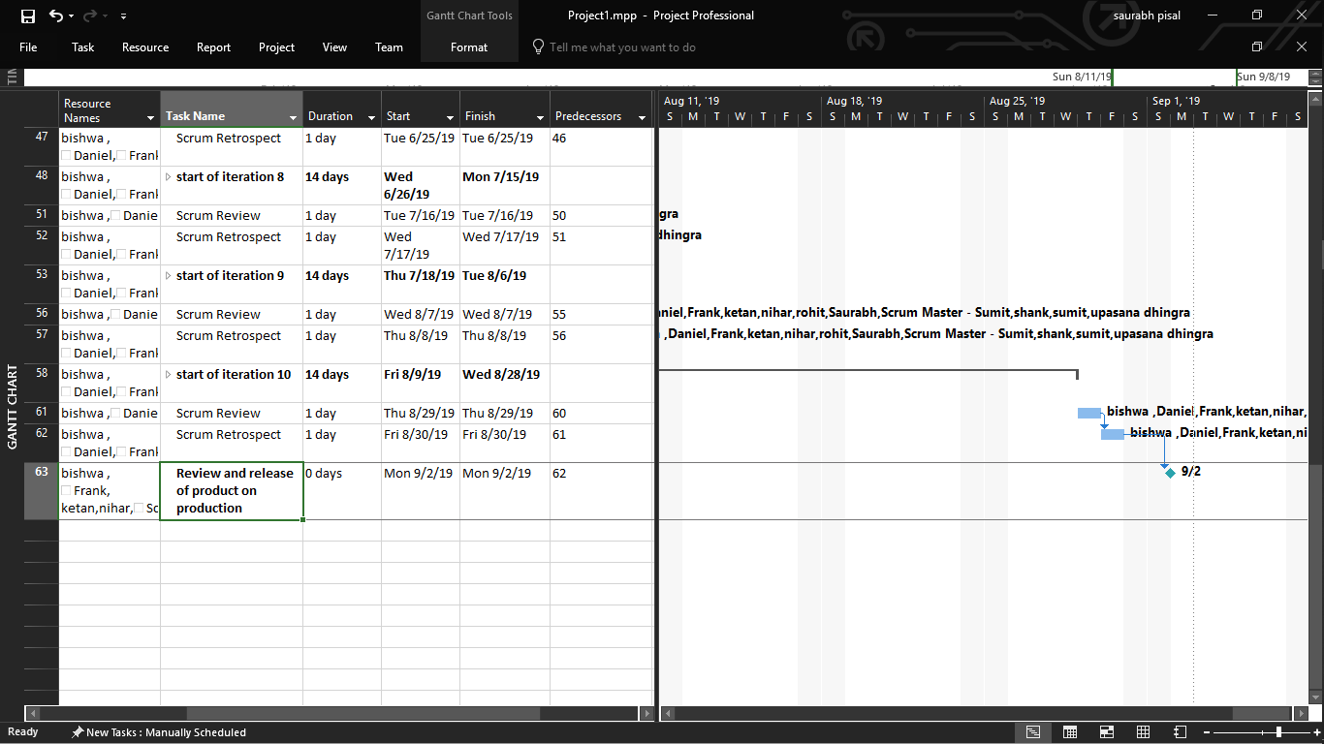

Slide 11
Resource Needed for The Project
A cross-functional team of 9 (plays role of tester, developer, UI designer)
1 PRODUCT OWNER (Maintaining Product Backlog and Data analysis to check requirement)
1 SCRUM MASTER (FACILITATOR)

Slide 12
Cost
Members | Rate
Number of hours estimated to build the product | 5-6 months = 24weeks = 120 Business days = 960hrs
Developer | $45/hour = $43,200*6=$2,59,200
UI developer | $50/hour = $48,000
Tester | $33/hour = $31,680
Product Owner | $65/hour = $62,400
Scrum Master | $65/hour = $62,400
Total Cost Investment | =$4,63,680
Maintenance cost is expected to be 0 for first year and $7,000 for 1st year and 10% increase every year further

Slide 13
Expected Cash flow
Expected Rate of cash flow | Maintenance 10% yearly | Difference
$ 100,000.00 | $0 | $ 100,000.00
$ 150,000.00 | $ 7,000.00 | $ 143,000.00
$ 200,000.00 | $ 7,700.00 | $ 192,300.00
$ 250,000.00 | $ 8,470.00 | $ 241,530.00
$ 300,000.00 | $ 9,317.00 | $ 290,683.00
$ 350,000.00 | $ 10,248.70 | $ 339,751.30
$ 400,000.00 | $ 11,273.57 | $ 388,726.43
$ 450,000.00 | $ 12,400.93 | $ 437,599.07
$ 500,000.00 | $ 13,641.02 | $ 486,358.98
$ 550,000.00 | $ 15,005.12 | $ 534,994.88

Slide 14
NPV
Npv = (1,00,000)/(1.15) + {(1,43,000)/(1.15)^2} + {(1,92,300)/(1.15)^3} + {(2,41,530)/(1.15)^4} + {290683/(1.15)^5} + {339751.30/(1.15)^6} – (534,994.88 )
= 575,448.69 – 4,63,680
= $111768.70
From NPV it is understood that the initial investment can be recovered within 6 years of active application with predicted cash flow

Slide 15




Quality matrix???
Check the velocity for first 2-3 iterations
Make a note of the velocity and use it as a reference while the team drives in a capacity-driven iteration
Test-driven development at place to test developments in each iteration to avoid future failure

Slide 16
risks
Sick leaves
Scrum master goes on a vacation

Slide 17
retrospect
We don’t have a retrospect yet on this project
But based on teams work in previous scrum projects, the team can work on their communication and handovers for dependent work

Slide 18
Thank you

